Slide 1
Risk Classification for Prudential Life Insurance
CS 513
Knowledge Discovery & Data Mining

Slide 2



The Data Sharks
Brendan Reis
Karel Lahmy
Mounika Bandam

Slide 3
The Challenge Prudential Life Insurance Assessment
Founded in 1875; headquarters in New Jersey
Some of the products and services:
Life Insurance, Mutual Funds, Retirement, Annuity, Real Estate
Life insurance application process is antiquated
Process can take up an average of 30 days
Only 40% US household own individual life insurance
Build an predictive model that classifies the risk using an automated approach

Slide 4
Dataset
https://www.kaggle.com/c/prudential-life-insurance-assessment/data
127 variables (columns), ~59K rows
Variables divide into the following:
Categorical (nominal) – Product info, Employment Info, Insured info, Insurance History & Medical History
Continuous – Age, Height, Wright, BMI, Employment Info, Family History
Discrete – Medical History, Medical Keyword
Target Variable – "Response" is an ordinal measure of risk that has 8 levels.
Challenges:
We are “blind” to the actual content
Domain Knowledge

Slide 5
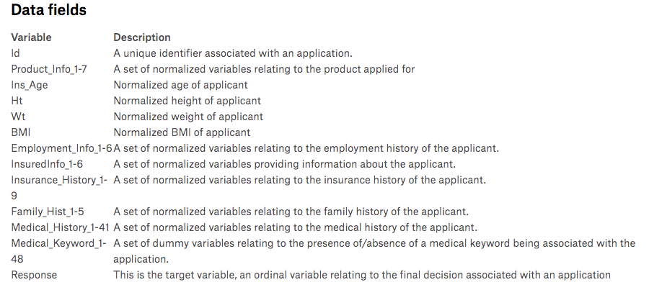
Dataset

Slide 6
Analyzing the Dataset
“The difference between an average data scientist and a master data scientist…”
Filled the missing values with mean, median
Approached variable selection method
Remove unnecessary columns (Medical Keyword)
Remove columns that have high percentage of missing values
Remove columns that do not disperse “properly” (80/20 rule)

Slide 7
Response Breakdown

Slide 8
Algorithms Used
KNN
KKNN
K-Means
Random Forest
Neural Networks
Logistic Regression
CART
C4.5
C5.0

Slide 9
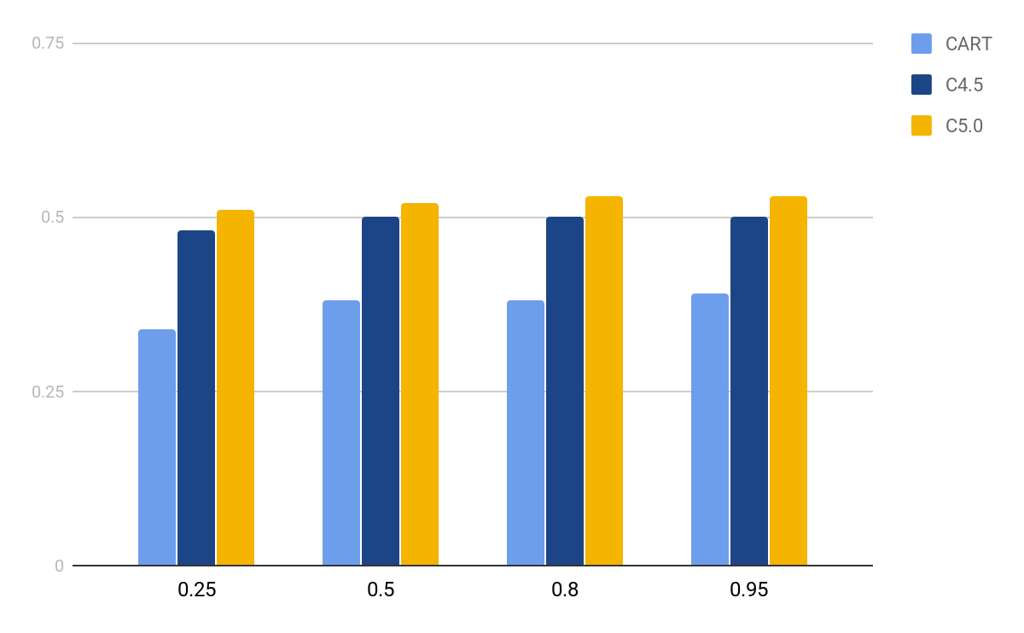
Accuracy with Different Training Split Fractions​ (CART / C4.5 / C5.0)​

Slide 10
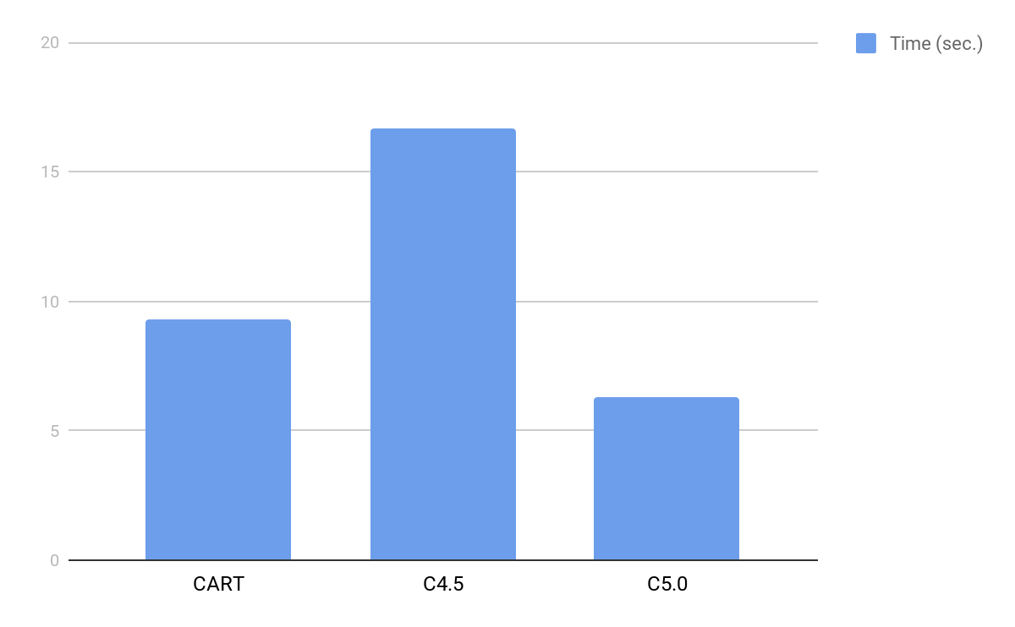
Time to Generate Model (CART / C4.5 / C5.0)​

Slide 11
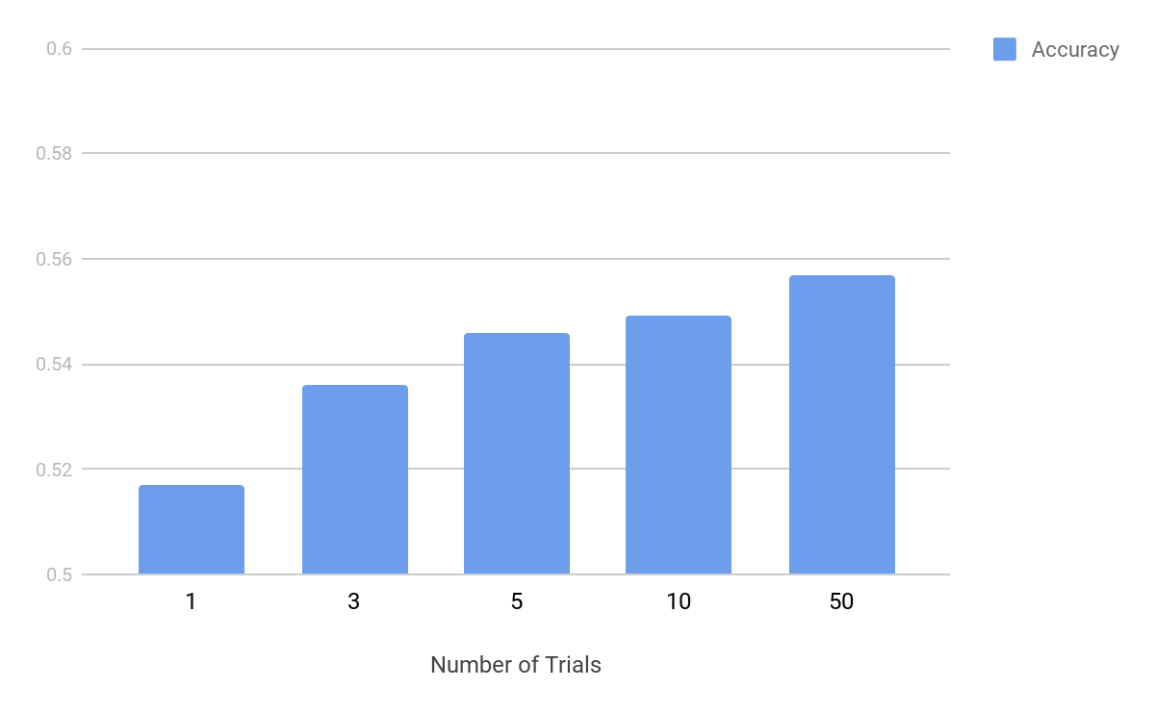
C5.0 Accuracy with Different Trial #’s

Slide 12
The K’s - KNN, KKNN & KMEANS
KMEANS:
With all columns but keywords – 0.115
With some columns – 0.134
KNN:
Started with K=5 using all columns but keywords - 0.331
Continue to increase K to find Optimal – k = 25 - 0.361
Removed columns based on data analysis - 0.362
KKNN:
Picked from K = 25 with all columns but keywords – 0.425
With some columns and different kernel options - “inv” – 0.437
With some columns and different kernel options - “inv” and using distance = 1 – 0.447

Slide 13
Random Forest
Fits a number of decision tree classifiers
Uses averaging to improve predictive accuracy
Controls Overfitting
Parameter Fine Tuning
Ntree(number of trees in the forest) = 500
Mtry(number of predictors sampled for splitting at each node)
Sampsize(size of the sample to draw)

Slide 14
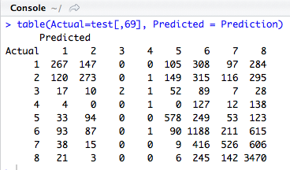

Random Forest(Conti…)

Slide 15
Logistic Regression
Multinomial logistic regression
Output is interpreted as probability
Output is also interpreted as class
Used nnet.multinom function

Slide 16
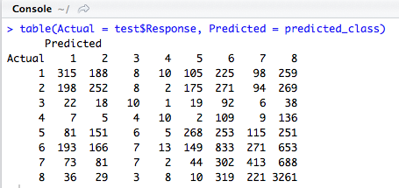

Logistic Regression(Conti…)

Slide 17
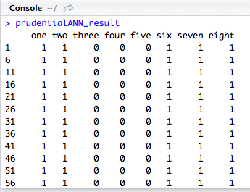
Neural Networks
Model creation is taking more than 4 hours
Not rendering the results with the categorical values
Rendering the results only for one hidden layer
Tried with first 10000 records to see the result
Implemented multi output neural network, no luck

Slide 18
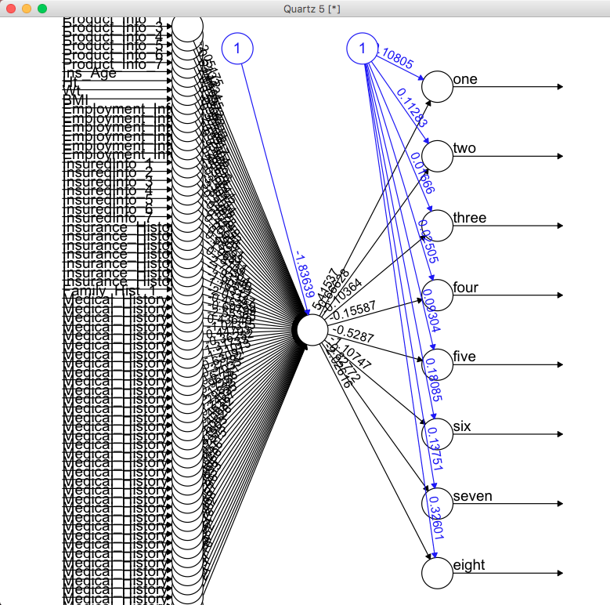
Neural Network(Conti…)

Slide 19
Problems Faced
Handling the missing values
Handling the large data affected the processing speed
Fine tuning the models

Slide 20
Way Forward…
Combine the models to improve the accuracy
Exploring the other methodologies like SVM, XGBoost
Embed samples in 2Dspace using PCA

Slide 21
Conclusion
We trained the data on various methodologies like Random Forest, Logistic Regression and K-Nearest Neighbor classifiers, CART
Random Forest clocked the maximum prediction accuracy of 54%
Streamline the process of life insurance risk classification

Slide 22
Thank you

